Slide 1
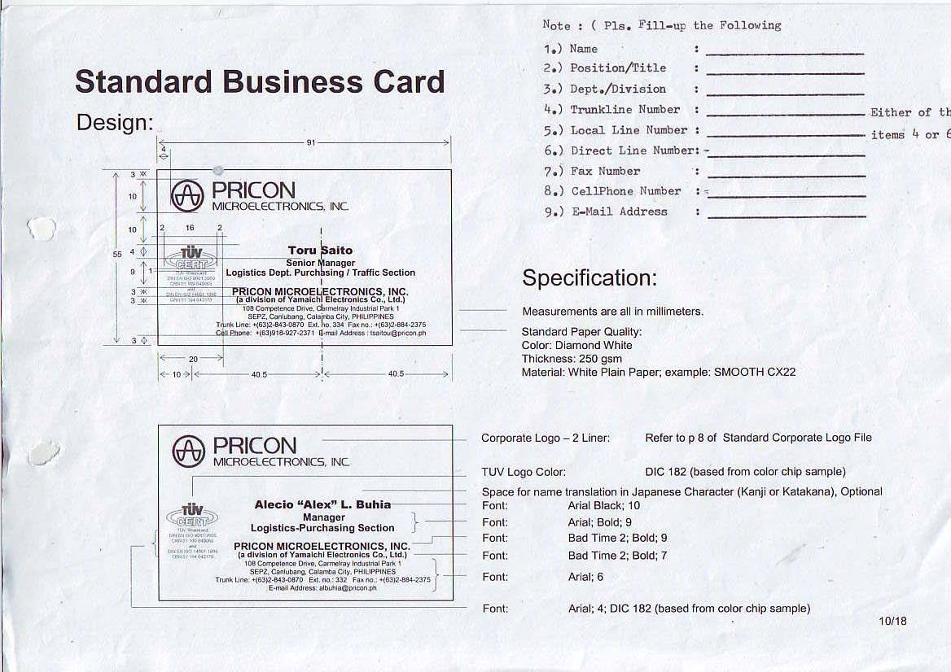
Ronnel O. Matampale
Jr. Engineer
Operations Eng'g Section
+(63) 2-843-0870
234
--
+(63)2-519-4183
+(63) 927-126-6077
romatampale@pricon.ph

Slide 2
Jerico E. Mendiola
Sr. Engineer
Operations Eng'g Section
+(63) 2-843-0870
234
--
+(63)2-519-4183
+(63) 956-584-9076
jemendiola@pricon.ph

